Slide 1
Flux Notes on Voice Pre-Working Session Discussion
July 19, 2018

Slide 2
Objectives for Today
Review plan / initial slides for Monday’s (7/23) working session (Salim Semy)
Walk through current end-to-end demonstration and initial results, specifically for:
Speech-to-Text (Weiye Ma)
Natural Language Processing (David Tresner-Kirsch)
Review working draft of storyboard for demonstration (Edwin Choi)

Slide 3
Flux Notes on Voice
Mission:
Capture accurate, verified
patient stories
and
structured patient health data
from conversational patient-clinician meetings (F2F and/or remote).
Goal:
Marginally reduce clinician burden compared to EHR-based structured data entry of 2017.
The Patient Stories and their Structured Patient Health Data are the targets; “capture burden” is the obstacle to reduce.

Slide 4
Team
Salim Semy: Task Lead
Harry Sleeper: Strategy Advisor
Joey Nichols: Clinical SME
Brian Anderson: Clinical SME
Cheryl Clark: Natural Language Processing SME
Weiye Ma: Speech to Text
David Tresner-Kirsch: Natural Language Processing
Rob Horn: Mobile / Web App Development; POC to Flux Notes team
Andy Hunt: Mobile / Web App Development
Juhan Sonin and Edwin Choi: User Experience Design

Slide 5

Minimum Viable Product (as of 18 Jul 2018)
The MVP for this task is a prototype mobile app that can:
recognize in conversational speech,
capture digitally,
confirm via touch, and then
update in Flux Notes
two structured cancer core data elements: 1. disease status and 2. toxicity, using the relevant Oncology SHR value sets
by 24 September 2018
Google Cloud
Audio
Transcribed text
Structured data
Intent Library
Flux Notes™
iOS app
Audio
ASR service
Commands
(JSON)
Browser (web app)
iPad

Slide 6
Deliverables
Demonstration of “Flux Notes on Voice”
Whitepaper or briefing documenting:
Initial assessment of “voice technology”
Lessons learned from proof of concept implementation
Recommended next steps
Intended Outcome: Determine whether we can use existing “voice” solutions in a reliable manner that captures the patient’s story and supports extraction of structured data for clinical research while reducing clinician burden

Slide 7

High-Level Timeline and Milestones (Notional)
CMS Demo
Focus for Today
FN Modes + Rosie 10 min
SVP Demo
9/24
FN Modes 5-10 min
Design / Build / Test
9/10
7/23 to 9/24
Feasibility Assessment
Start: 6/18
9 Weeks
01
02
03
04
05
2.5 Weeks
2 Weeks
Week 1 2 3 4 5 6 7 8 9 10 11 12 13 14 15
Begins 6/18 6/25 7/2 7/9 7/16 7/23 7/30 8/6 8/13 8/20 8/27 9/3 9/10 9/17 9/24

Slide 8
Feasibility Assessment (1 of 2)
Objective: Determine what we can accomplish using existing solutions, identify gaps, and develop a plan to establish Flux Notes on Voice MVP
Technical Approach: (see next slide)
Record Encounters
Mobile App
Storyboard: Develop storyboard for (video recording of) demonstration
Outcome: An initial plan to establish Flux Notes on Voice MVP
Definition of the MVP
Timeline with key milestones
Speech-to-Text
Natural Language Processing
Integration with Flux Notes
Roles and responsibilities
Drum beat (Agile process, supporting tools, etc.)
Deliverables

Slide 9
Feasibility Assessment – Technical Approach
Structured Phrase
Audio
Audio
Transcription
#
Record Encounters
Flux Notes on Voice Mobile App
Speech-to-Text
Natural Language Processing
Flux Notes
Focus: Generate sample data that ranges from natural conversation to structured dialogue to evaluate technologies | Focus: Validate receiving audio via Bluetooth microphone and sending it to Google speech-to-text service. | Focus: Evaluate existing speech-to-text services to transcribe encounter in a reliable manner | Focus: Evaluate existing NLP capabilities to extract structured data from transcribed encounter for sample data | Focus: Define interface to send structured data to Flux Notes
July 23: Audio recordings and human transcription and annotation of 8-12 synthetic encounters based on discussion guide | July 23: Sample mobile app working on Android device interacting with Google speech-to-text; | July 23: Automated speech-to-text of sample data; recommend speech-to-text service to use for prototype; identify gaps; | July 23: NLP of sample data; recommend NLP capability to use for prototype; identify gaps | July 23: Results of Flux Notes testing in Safari, initial design of commands and plan for coordination and integration testing\

Slide 10
End-to-End Demonstration
Natural Language Processing
Speech-to-Text
Google Cloud Speech-to-Text
IBM Watson Natural Language Processing
Generation of Structured Phrase
Recording Synthetic Encounters
8 synthetic encounters conducted by 2 clinicians and 8 patient actors
3 captured via iPad
3 captured via iPhone
2 captured via Jabra Mic
Word Error Rate
????
Acceptable thresholds?
????
Metrics
Human Transcription
Human Annotation of References to Disease Status and Toxicity
Human Creation of Structured Phrase
Objective: Demonstrate what is possible using existing capabilities, assess whether they have acceptable performance (based on defined thresholds) and determine how we change the approach accordingly

Slide 11
Recording Synthetic Encounters
Approach:
Develop “discussion guide” to guide the synthetic encounter
Clinician (Joey and Brian) conducts encounter with patient actors
Experiment with multiple recording devices and degree of structured dialogue
Results:
Recordings are available here
Human transcription and annotations are available here
Summary of Findings:
Consider alternative microphones – ideal bandwidth for speech recognition is 50-8KHz
Jabra Bluetooth Speaker: 6.5KHz (model 710 is 7KHz)
iPad Microphone: 220KHz
Determine if additional structure is needed in dialogue to improve NLP performance

Slide 12
Speech-to-Text
Approach:
Results:
Summary of Findings:
Assessment of technology
Gaps that need to be addressed
Outstanding issues
Recommended next steps
Weiye to fill out

Slide 13
Natural Language Processing
Approach:
Results:
Summary of Findings:
Assessment of technology
Gaps that need to be addressed
Outstanding issues
Recommended next steps
David to fill out

Slide 14
Interface with Flux Notes
Test Flux Notes on Safari (initially on Mac, subsequently on iPad)
Define format and interface for commands to Flux Notes
Call to JavaScript function?
Coordination across Flux Notes and Flux Notes on Voice efforts
NLP: ensure David Tresner-Kirsch and Sam Bayer are talking
Member of Flux Notes on Voice team participate in Flux Notes Scrum
Approach and timeline for integration testing

Slide 15
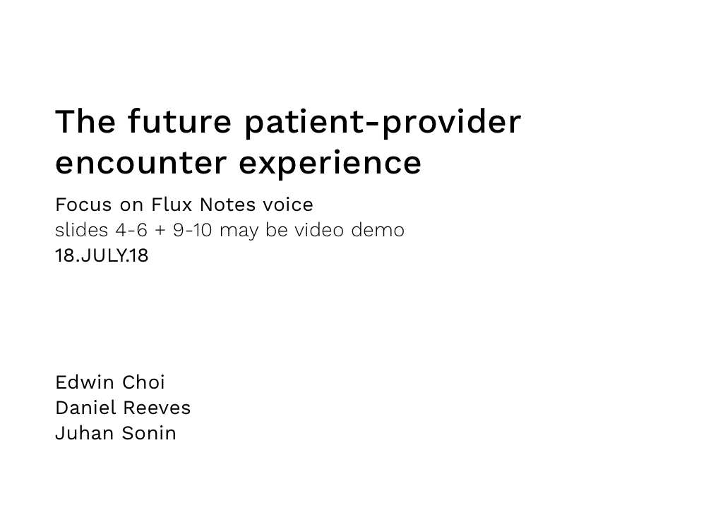
Storyboard

Slide 16
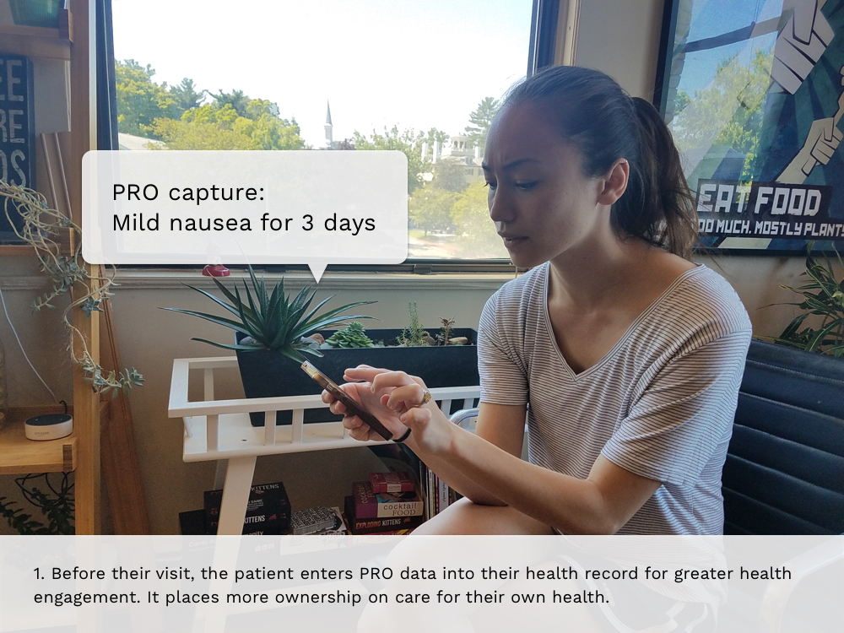
Storyboard

Slide 17
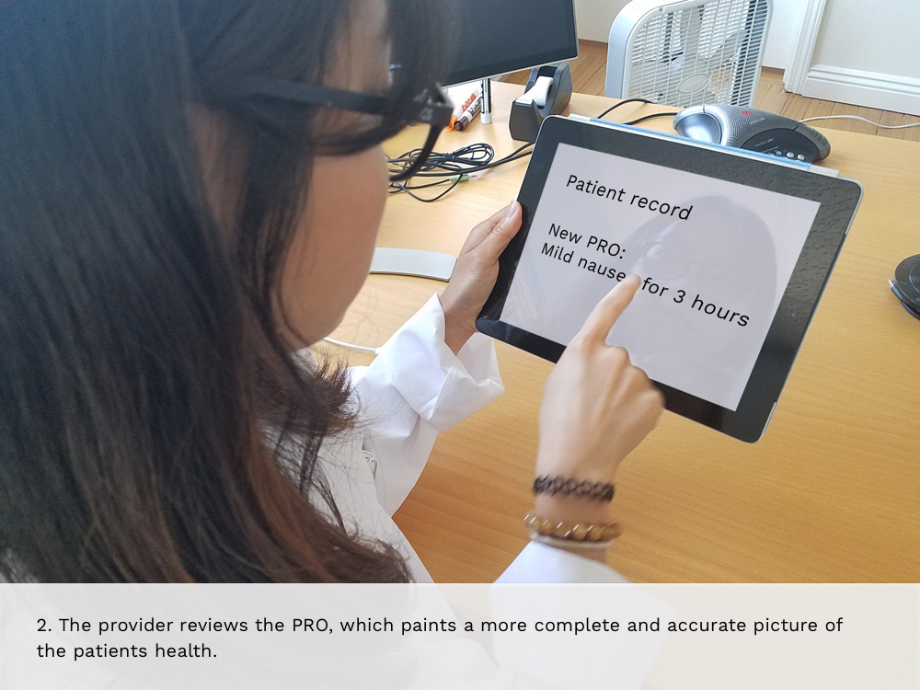
Storyboard

Slide 18
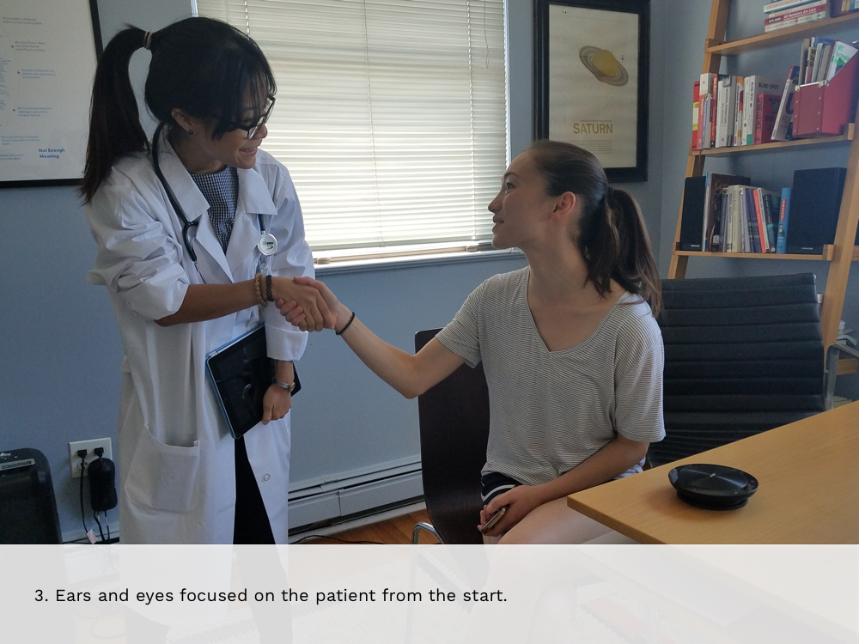
Storyboard

Slide 19
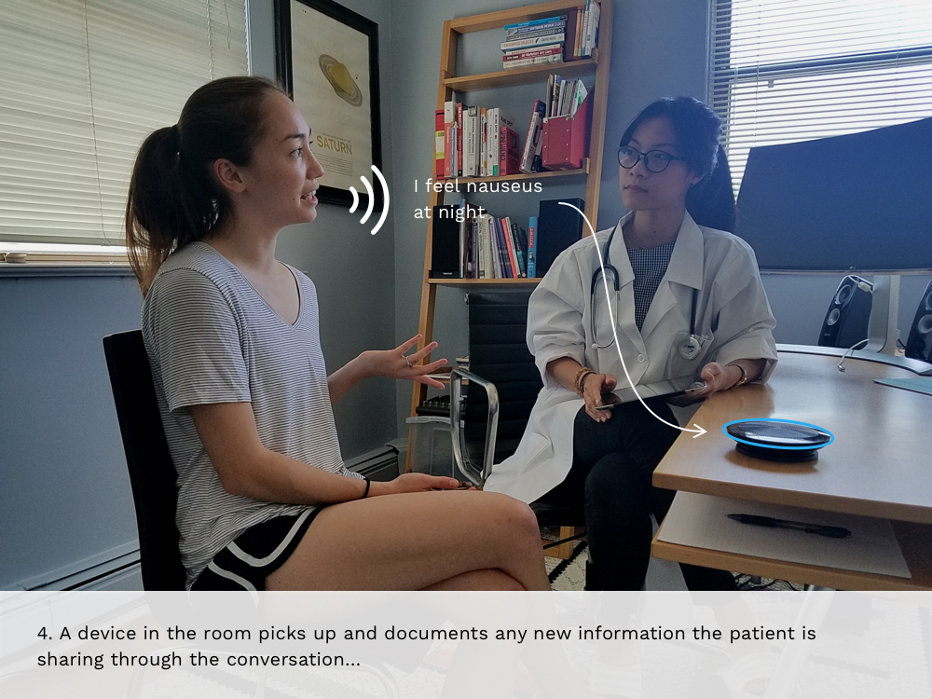
Storyboard

Slide 20
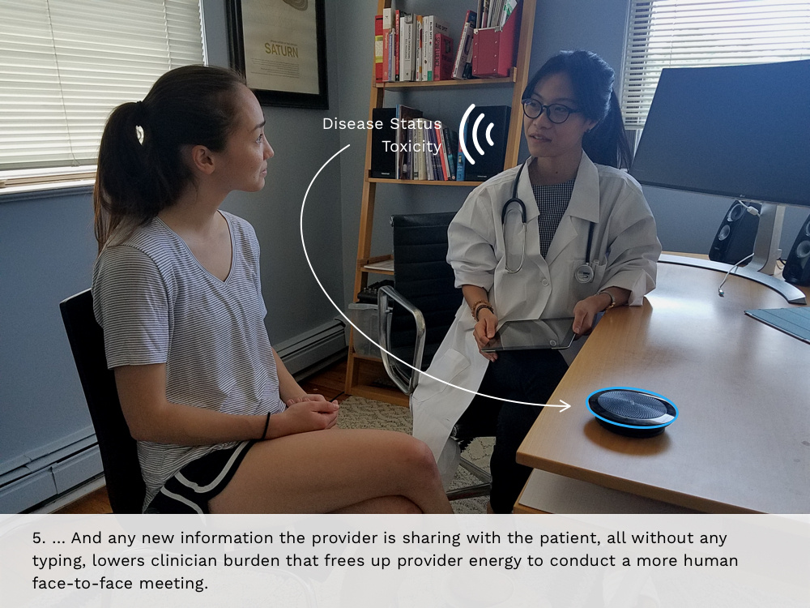
Storyboard

Slide 21
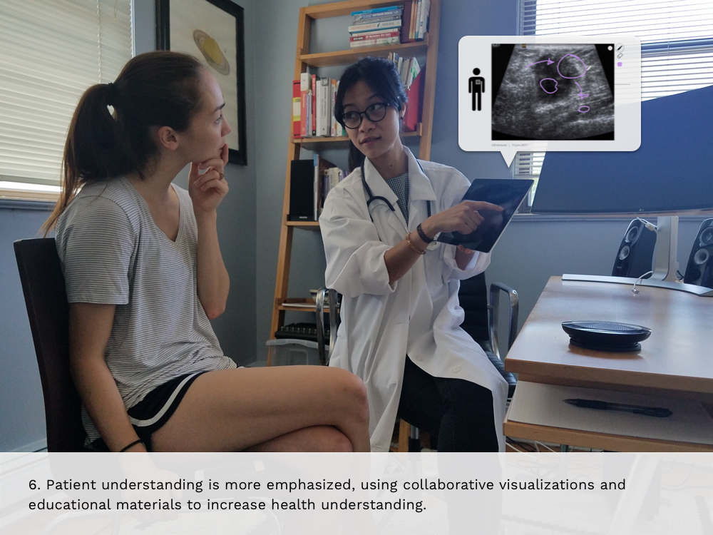
Storyboard

Slide 22
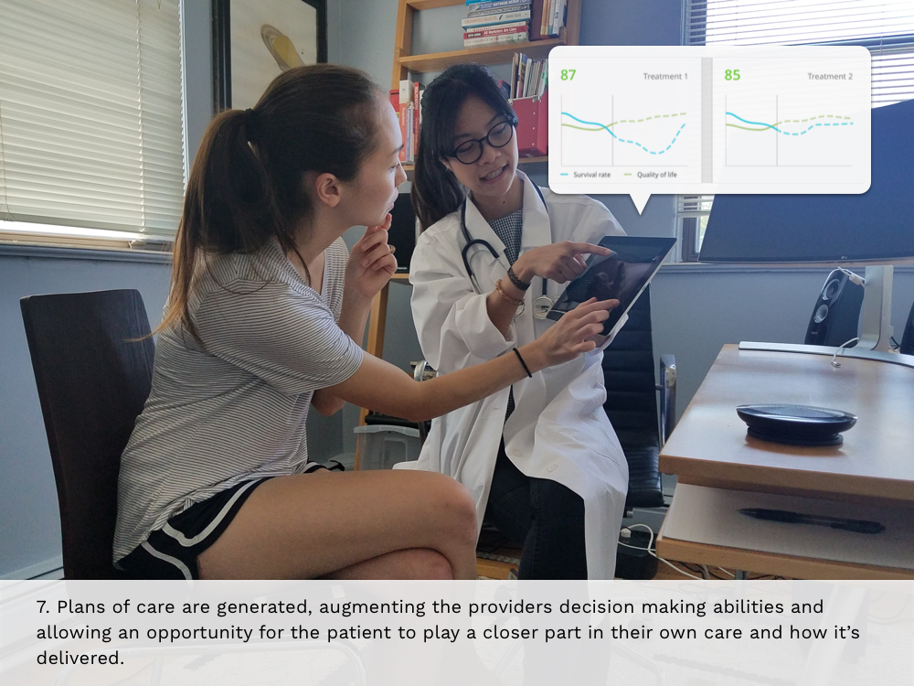
Storyboard

Slide 23

Storyboard

Slide 24
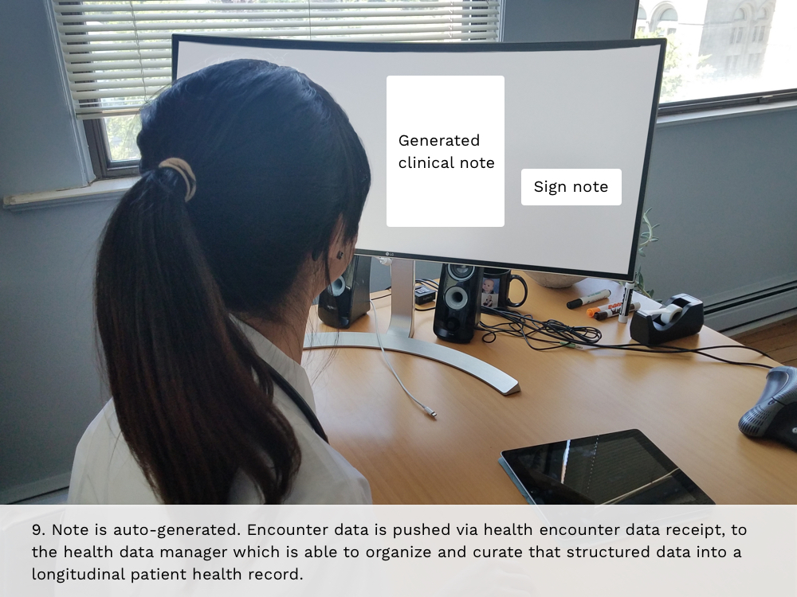
Storyboard

Slide 25
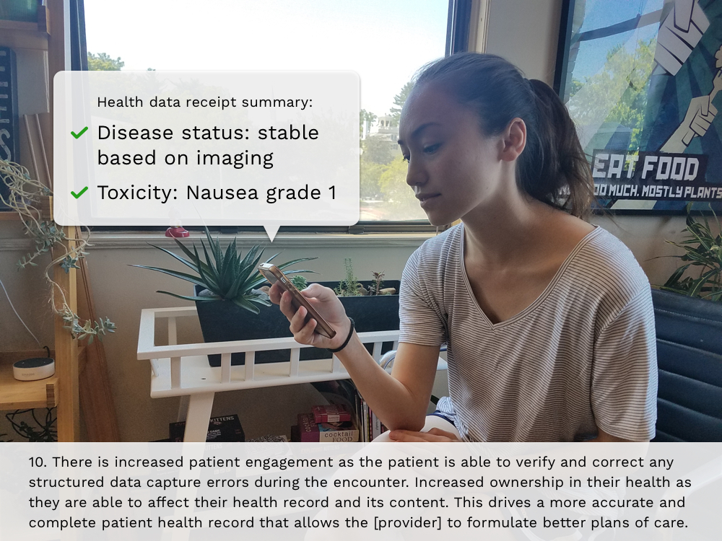
Storyboard

